Slide 1
ECOMM SALES ANALYSIS
PRESENTED BY
SHADAB ALAM SIDDIQUEE & SALONI JAISWAL

Slide 2
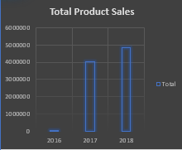
Total Sales of Product
It represents the total sales of product yearly.
The minimum sales was reported in the year
2016.
And highest sales is in the year 2018,
which means sales are increasing
day by day.

Slide 3
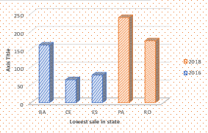
Lowest Sales In State
Here we represent lowest sales in states.
So in 2016 state CE has the lowest no of
sales
And in 2018 state RO has lowest no of
sales.

Slide 4
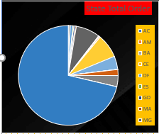
Total order of the states
It represent the total percentage of order
according to states.
Here SP state has the maximum number of orders
which is 71%.
Which means SP state is more interested in
purchasing.

Slide 5
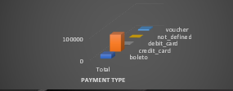
Payment Modes
Here we represents the payment modes.
We can easily see in the chart customers
likes most to pay through the credit card.
And less transaction are of debit card.
We can interpret that credit card is more
popular payment mode.

Slide 6
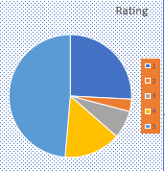
Rating From The Customers
Here we represents the rating of the product
Annually.
So max rating 5 is 49%, which means many of
customer likes our products.
And 3% of customer rate us 1, which is min
rating.

Slide 7
THANK YOU

